Slide 1



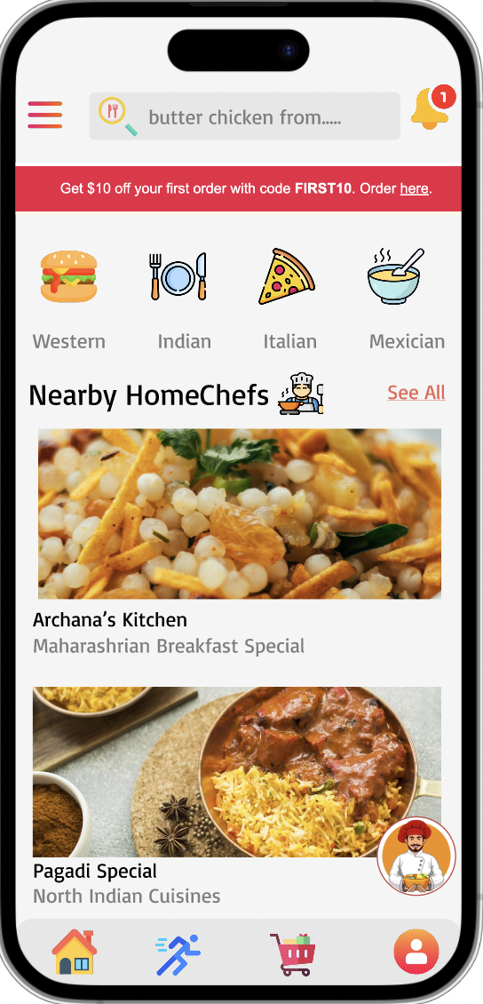








MAP-A-MEAL
A digital platform for home cooks to deliver fresh home cooked meals
Gaurav
Patil
Sanora
Gonsalves
Varsha
Kamalaksha
Aman
Malawade
Yashneil
Sawjiani
Team 8: The Mealtime Mavericks
*Images are only for reference purpose
Spring 2023

Slide 2

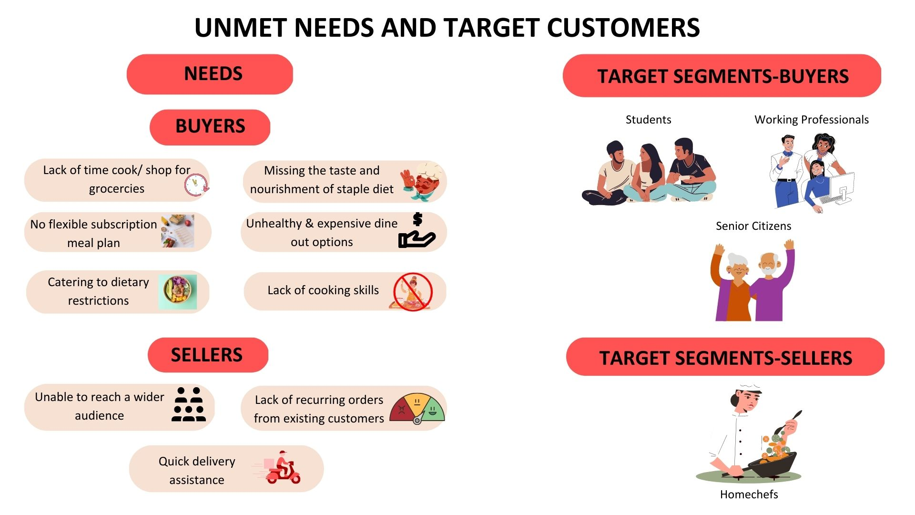
Needs & Customer Segment
*Images are only for reference purpose
Spring 2023

Slide 3
Proposed Solution
Vision
To create a digital platform delivering healthy home-cooked meals for busy individuals
looking for nutritious, convenient food delivery options right at their doorstep.
Healthly
Home Cooked
Tracking
H.E.A.L.T.H
Easy Subscription
Loyalty
Affordable
*Images are only for reference purpose
Spring 2023

Slide 4
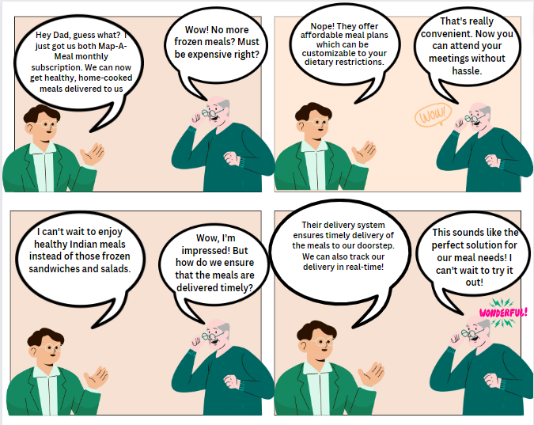
Visual Storyboard
*Images are only for reference purpose
Spring 2023
*Images are only for reference purpose

Slide 5

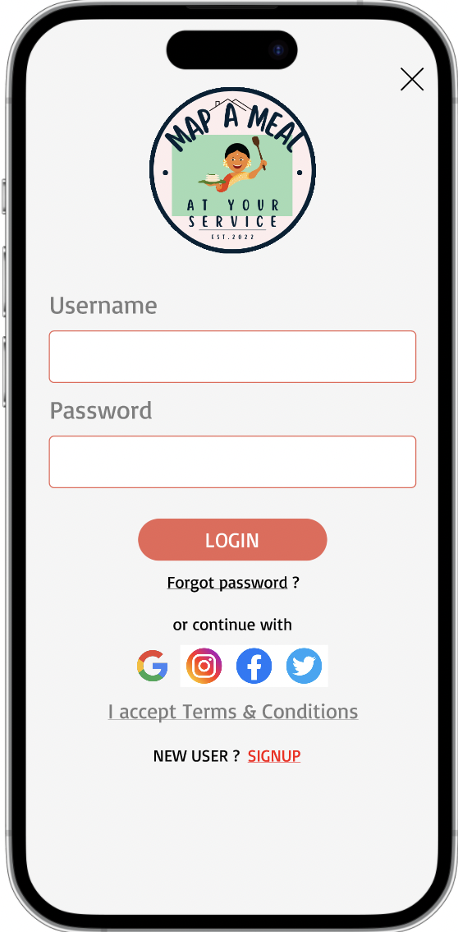
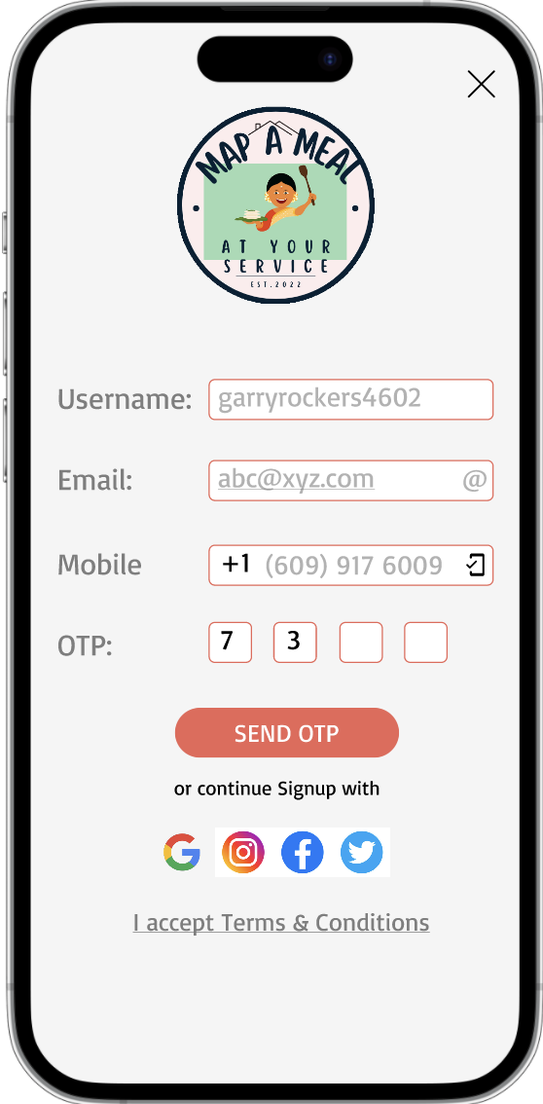
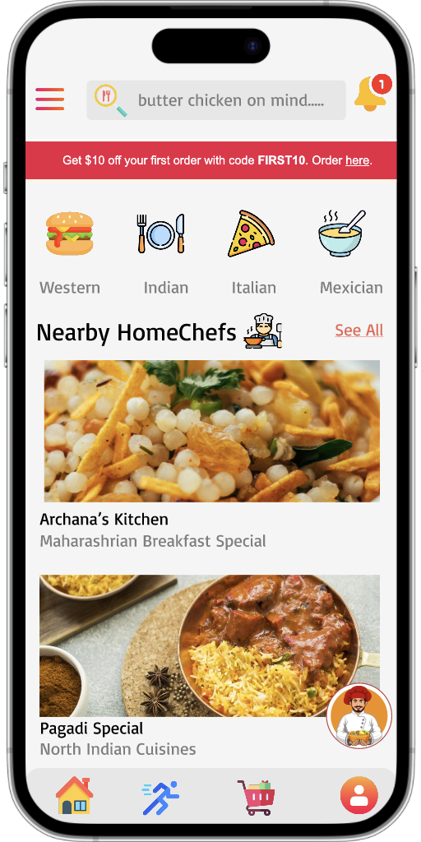
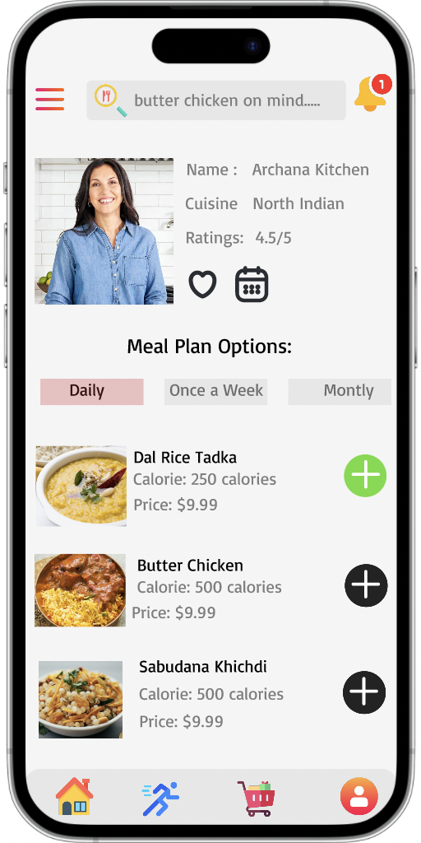
Visual Storyboard
Hi - Fi Prototypes
*Images are only for reference purpose
Spring 2023

Slide 6
Product Roadmap
Feature Additions
Scalability
Referrals & Loyalty
Customized Meal Plan
Live Order Tracking
AI Chatbot
Partnerships
Q1
Q3
Q2
Q4
Market Research + Product Development Launch
Monetization
Premium Subscription
Ad Monetization
Market Survey + User Interviews &
MVP launch
*Images are only for reference purpose
Spring 2023

Slide 7





Product Features
Customized Menu Options
Flexible Subscription Plans
Real Time
Meal Tracking
Earn & Redeem Loyalty Points
Secured Payment Gateways
Live Customer Support
*Images are only for reference purpose
Spring 2023
*Images are only for reference purpose

Slide 8













Features MVP Launch
HOME CHEF PROFILE
REVIEWS & RATINGS
CUSTOMER
MEAL CUSTOMISATION
ORDER MANAGEMENT
USER REGISTRATION
MENU MANAGEMENT
PAYMENT MANAGEMENT
$
CHEF
CHEF REGISTRATION
ORDER ACCEPTANCE & MANAGEMENT
*Images are only for reference purpose
Spring 2023

Slide 9











Key Metrics
INSTALL-TO-ORDER CONVERSION RATE
TOTAL NUMBER OF ORDERS PLACED DAILY
REPEAT PURHASE
RATE
SUBSCRIPTION
CONVERSION RATE
NET PROMOTER
SCORE
CUSTOMER LIFETIME
VALUE
ACQUISITION
ENGAGEMENT
RETENTION
*Images are only for reference purpose
Spring 2023

Slide 10
Operational Needs
Customer Support
Robust Infrastructure
Delivery Management
Provide customers a live chat bot to address their issues and concerns
To handle high volume and traffic of active users
Real time meal tracking on the mobile app with live status updates
Data Privacy
Quality Control
Protection of the sensitive personal information provided by customers during everyday app usage
Explicit quality control standards for home chefs including
periodic quality control checks
*Images are only for reference purpose
Spring 2023

Slide 11
Projected Costs
DEVELOPMENT
COSTS
MARKETING
& ADVERTISING
INFRASTRUCTURE
COSTS
OPERATIONAL
COSTS
MISCELLANEOUS
COSTS
The cost of hiring developers, UI/UX designers, QA testers
Cost of Marketing and the app to attract customers
Cost of maintenance of the server infrastructure used to host and the application
Cost of administering the everyday functioning of the app
Costs required to cover legal docs, licensing & meal peackaging
$25,000
per month
$3,000
per month
$7,000
per month
$8,000
per month
$2,000
per month
TOTAL PROJECTED COST = $45,000/month OR $540,000/year
*Images are only for reference purpose
Spring 2023

Slide 12






Risks & Mitigation Plan
Food
Safety
Legal
Liability
Delivery
Logistics
Customer
Complaints
Payment
Fraud
Market
Competition
Food Safety Training
For All Home Chefs
Instruction Manual for Safe Food Handling Techniques
Ensure Food Permits For All Home Chefs
Insurance Cover
For Every Seller
Delivery Instructions For All Home Chefs
Meal Tracking On The Mobile App With Live Status Updates
Live Chat Bot
Use Client Feedback To Constantly Improve The Platform
Secure Payment Processing Solutions
Fraud Detection Software To Monitor
Unusual Behavior
Wide Range Of Cuisines
Personalized Meal Plans
Loyalty Program
Live Meal Tracking
Alternative Options
For People With
Dietary Restrictions
*Images are only for reference purpose
Spring 2023

Slide 13
No More Meal Prep Stress
Let MAP-A-MEAL Take Care of You!
Thank You
*Images are only for reference purpose
Spring 2023

